Slide 1
Output Device: Printer

Slide 2
Printer
A computer printer, or more commonly a printer, produces a hard copy (permanent human-readable text and/or graphics) of documents stored in electronic form, usually on physical print media such as paper or transparencies. Many printers are primarily used as local computer peripherals, and are attached by a printer cable to a computer which serves as a document source. Some printers, commonly known as network printers, have built-in network interfaces (typically wireless or Ethernet), and can serve as a hardcopy device for any user on the network. Individual printers are often designed to support both local and network connected users at the same time.

Slide 3
Printer…
In addition, many modern printers can directly interface to electronic media such as memory sticks or memory cards, or to image capture devices such as digital cameras, scanners; some printers are combined with a scanners and/or fax machines in a single unit. Printers that include non-printing features are sometimes called Multi-Function Printers (MFP) or Multi-Function Devices (MFD). A printer which is combined with a scanner can function as a photocopier if so designed. Most MFPs include printing, scanning, and copying among their features

Slide 4
Printing technology
There are several major printer technologies available. These technologies can be broken down into two main categories with several types in each
    Impact Printer
    Non-impact Printer

Slide 5
Printing technology…
Impact Printer
These printers have a mechanism that touches the paper in order to create an image. There are two main impact technologies:
Dot matrix printers use a series of small pins to strike a ribbon coated with ink, causing the ink to transfer to the paper at the point of impact.

Slide 6
Key items to investigate when selecting a dot matrix printer
Number of wires in the head
Bidirectional printing capability
Form feed slew rate
Type of form feed mechanism
Paper width sizes supported
Number of columns that can be printed
Maximum dot resolution capability
Types and number of character fonts supported
Does the printer support the full IBM standard character set?
Variable line spacing support
What are the printer speeds (in CPS)
Is the APA graphics mode supported
Can the printer support both portrait and landscape printing?
Does the printer support any high level graphics language such as PostScript or HPL?

Slide 7
Printing technology…
Impact Printer ..
Character printers are basically computerized typewriters. They have a ball or series of bars with actual characters (letters and numbers) embossed on the surface. The appropriate character is struck against the ink ribbon, transferring the character's image to the paper. Character printers are fast and sharp for basic text, but very limited for other use.

Slide 8
Printing technology…
Non-Impact Printer
These printers do not touch the paper when creating an image. Inkjet printers are part of this group, which includes:
Inkjet printers, use a series of nozzles to spray drops of ink directly on the paper.

Slide 9
Printing technology…
Non-Impact Printer…
Laser printers, use dry ink (toner), static electricity, and heat to place and bond the ink onto the paper.
Solid ink printers contain sticks of wax-like ink that are melted and applied to the paper. The ink then hardens in place.

Slide 10
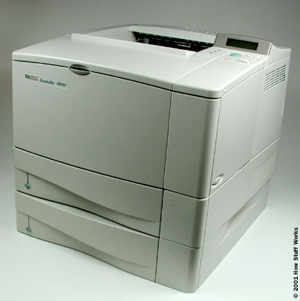
Laser printers
CRT screen size
CRT screen size
A Hewlett Packard LaserJet 4050T

Slide 11
Printing technology…
Liquid inkjet printers
Inkjet printers spray very small, precise amounts (usually a few picolitres) of ink onto the media. These droplets of ink will carry a slight electrical charge. The placement of the ink on the page is then determined by the charge of a cathode and electrode between which the ink moves towards the paper. Inkjet printing (and the related bubble-jet technology) are the most common consumer print technology; as high-quality inkjet printers are inexpensive to produce.

Slide 12
Printing technology…
Liquid inkjet printers ..
If you ever look at a piece of paper that has come out of an inkjet printer, you know that:
The dots are extremely small (usually between 50 and 60 microns in diameter), so small that they are tinier than the diameter of a human hair (70 microns)!
The dots are positioned very precisely, with resolutions of up to 1440x720 dots per inch (dpi).
The dots can have different colors combined together to create photo-quality images.

Slide 13
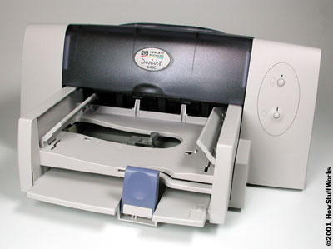
Inkjet Printers
An inexpensive color inkjet printer made by Hewlett Packard.

Slide 14
Printing technology…
Liquid inkjet printers
Different types of inkjet printers form their droplets of ink in different ways. There are several technologies used by printer manufacturers, but by far the most popular technique is the bubble jet. In a bubble jet printer, tiny resistors create heat, and this heat vaporizes ink to create a bubble. The expansion that creates the bubble causes a droplet to form and eject from the print head. A typical bubble jet print head has 64 or 128 tiny nozzles, and all of them can fire a droplet simultaneously.

Slide 15
Printing technology…
Inside an inkjet printer
Parts of a typical inkjet printer include:
Print head assembly
Print head - The core of an inkjet printer, the print head contains a series of nozzles that are used to spray drops of ink.

Slide 16
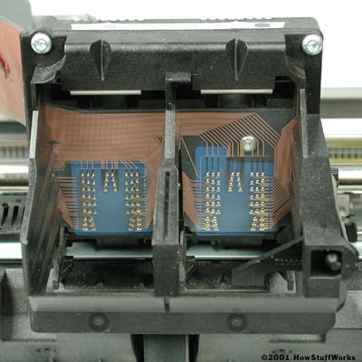
Inkjet Printers
The print head assembly
.

Slide 17
Inside an inkjet printer
Print head assembly
Ink cartridges - Depending on the manufacturer and model of the printer, ink cartridges come in various combinations, such as separate black and color cartridges, color and black in a single cartridge or even a cartridge for each ink color. The cartridges of some inkjet printers include the print head itself.

Slide 18
Inside an inkjet printer
Print head assembly
Print head stepper motor - A stepper motor moves the print head assembly (print head and ink cartridges) back and forth across the paper. Some printers have another stepper motor to park the print head assembly when the printer is not in use. Parking means that the print head assembly is restricted from accidentally moving, like a parking brake on a car.

Slide 19
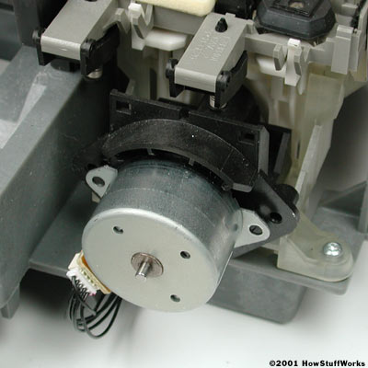
Inside an inkjet printer
Print head stepper-motor

Slide 20
Inside an inkjet printer
Print head assembly
Belt - A belt is used to attach the print head assembly to the stepper motor.
Stabilizer bar - The print head assembly uses a stabilizer bar to ensure that movement is precise and controlled.

Slide 21
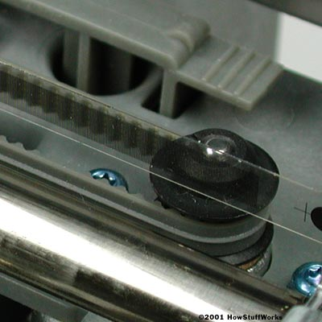
Inside Inkjet Printers
Here you can see the stabilizer bar and belt.
.

Slide 22
Inside an inkjet printer
Paper feed assembly
Paper tray/feeder - Most inkjet printers have a tray that you load the paper into. Some printers dispense with the standard tray for a feeder instead. The feeder typically snaps open at an angle on the back of the printer, allowing you to place paper in it. Feeders generally do not hold as much paper as a traditional paper tray.

Slide 23
Inside an inkjet printer
Paper feed assembly
Rollers - A set of rollers pull the paper in from the tray or feeder and advance the paper when the print head assembly is ready for another pass.
Paper feed stepper motor - This stepper motor powers the rollers to move the paper in the exact increment needed to ensure a continuous image is printed.

Slide 24
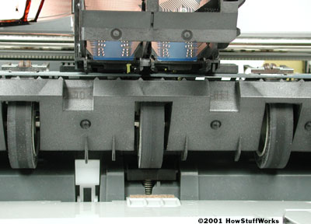
Inside Inkjet Printers
The rollers move the paper through the printer.
.

Slide 25
Inside an inkjet printer
Power supply - While earlier printers often had an external transformer, most printers sold today use a standard power supply that is incorporated into the printer itself.
Control circuitry - A small but sophisticated amount of circuitry is built into the printer to control all the mechanical aspects of operation, as well as decode the information sent to the printer from the computer.

Slide 26
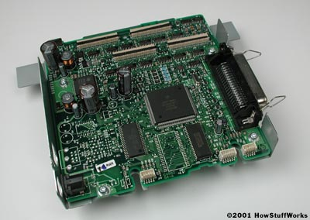
Inside Inkjet Printers
The mechanical operation of the printer is controlled by a small circuit board containing a microprocessor and memory.
.

Slide 27
Inside an inkjet printer
Interface ports
The parallel port is still used by many printers, but most newer printers use the USB port. A few printers connect using a serial port or small computer system interface (SCSI) port.

Slide 28
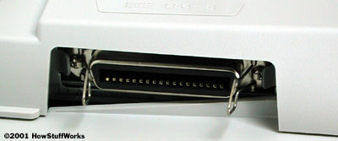
Inside Inkjet Printers
While USB taking over, many printers still use a parallel port.
.

Slide 29
Inkjet printing process
When you click on a button to print, there is a sequence of events that take place:
The software application you are using sends the data to be printed to the printer driver.
The driver translates the data into a format that the printer can understand and checks to see that the printer is online and available to print.
The data is sent by the driver from the computer to the printer via the connection interface (parallel, USB, etc.).

Slide 30
Inkjet printing process…
The printer receives the data from the computer. It stores a certain amount of data in a buffer. The buffer can range from 512 KB random access memory (RAM) to 16 MB RAM, depending on the model. Buffers are useful because they allow the computer to finish with the printing process quickly, instead of having to wait for the actual page to print. A large buffer can hold a complex document or several basic documents.

Slide 31
Inkjet printing process…
If the printer has been idle for a period of time, it will normally go through a short clean cycle to make sure that the print head(s) are clean. Once the clean cycle is complete, the printer is ready to begin printing

Slide 32
Inkjet printing process…
The control circuitry activates the paper feed stepper motor. This engages the rollers, which feed a sheet of paper from the paper tray/feeder into the printer. A small trigger mechanism in the tray/feeder is depressed when there is paper in the tray or feeder. If the trigger is not depressed, the printer lights up the "Out of Paper" LED and sends an alert to the computer.

Slide 33
Inkjet printing process…
Once the paper is fed into the printer and positioned at the start of the page, the print head stepper motor uses the belt to move the print head assembly across the page. The motor pauses for the merest fraction of a second each time that the print head sprays dots of ink on the page and then moves a tiny bit before stopping again. This stepping happens so fast that it seems like a continuous motion.

Slide 34
Inkjet printing process…
Multiple dots are made at each stop. It sprays the CMYK colors in precise amounts to make any other color imaginable.
At the end of each complete pass, the paper feed stepper motor advances the paper a fraction of an inch. Depending on the inkjet model, the print head is reset to the beginning side of the page, or, in most cases, simply reverses direction and begins to move back across the page as it prints.

Slide 35
Inkjet printing process…
This process continues until the page is printed. The time it takes to print a page can vary widely from printer to printer. It will also vary based on the complexity of the page and size of any images on the page. For example, a printer may be able to print 16 pages per minute (PPM) of black text but take a couple of minutes to print one, full-color, page-sized image. At the end of each complete pass, the paper feed stepper motor advances the paper a fraction of an inch. Depending on the inkjet model, the print head is reset to the beginning side of the page, or, in most cases, simply reverses direction and begins to move back across the page as it prints.

Slide 36
Inkjet printing process…
Once the printing is complete, the print head is parked. The paper feed stepper motor spins the rollers to finish pushing the completed page into the output tray. Most printers today use inks that are very fast-drying, so that you can immediately pick up the sheet without smudging it.

Slide 37
Inkjet print Quality
The paper you use on an inkjet printer greatly determines the quality of the image. There are two main factors that affect image quality:
        Brightness
        Absorption

Slide 38
Inkjet print Quality…
The brightness of a paper is normally determined by how rough the surface of the paper is. A course or rough paper will scatter light in several directions, whereas a smooth paper will reflect more of the light back in the same direction. This makes the paper appear brighter, which in turn makes any image on the paper appear brighter. You can see this yourself by comparing a photo in a newspaper with a photo in a magazine. The smooth paper of the magazine page reflects light back to your eye much better than the rough texture of the newspaper. Any paper that is listed as being bright is generally a smoother-than-normal paper.

Slide 39
Inkjet print Quality…
The other key factor in image quality is absorption. When the ink is sprayed onto the paper, it should stay in a tight, symmetrical dot. The ink should not be absorbed too much into the paper. If that happens, the dot will begin to feather. This means that it will spread out in an irregular fashion to cover a slightly larger area than the printer expects it to. The result is an page that looks somewhat fuzzy, particularly at the edges of objects and text.

Slide 40
Printing technology…
Toner based printers ….
The most common type of toner-based printer is the laser printer, which uses precision lasers to cause adherence. Laser printers are known for high quality prints, good print speed, and a low (Black and White) cost-per-copy; they are the most common printer for many general-purpose office applications. They are far less commonly used as consumer printers due to a high initial cost. Laser printers are available in both color and monochrome varieties. Another toner based printer is the LED printer which uses an array of LEDs instead of a laser to cause toner adhesion to the print drum.

Slide 41
Toner based printers …
Laser Printer basics: Static Electricity
The primary principle at work in a laser printer is static electricity, the same energy that makes clothes in the dryer stick together or a lightning bolt travel from a thundercloud to the ground. Static electricity is simply an electrical charge built up on an insulated object, such as a balloon or your body. Since oppositely charged atoms are attracted to each other, objects with opposite static electricity fields cling together.

Slide 42
Toner based printers …
Laser Printer basics: Static Electricity …
A laser printer uses this phenomenon as a sort of "temporary glue." The core component of this system is the photoreceptor, typically a revolving drum or cylinder. This drum assembly is made out of highly photoconductive material that is discharged by light photons.

Slide 43
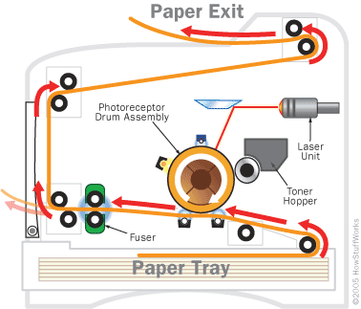
Laser Printer basics
The path of a piece of paper through a laser printer
.

Slide 44
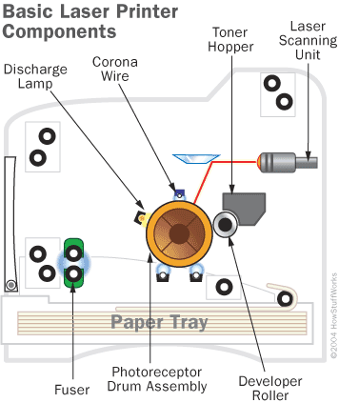
Laser Printer basics
The basic components of a laser printer
.

Slide 45
Toner based printers …
Laser Printer basics: Drum
Initially, the drum is given a total positive charge by the charge corona wire, a wire with an electrical current running through it. (Some printers use a charged roller instead of a corona wire, but the principle is the same.) As the drum revolves, the printer shines a tiny laser beam across the surface to discharge certain points. In this way, the laser "draws" the letters and images to be printed as a pattern of electrical charges -- an electrostatic image. The system can also work with the charges reversed -- that is, a positive electrostatic image on a negative background.

Slide 46
Toner based printers …
Laser Printer basics: Drum..
After the pattern is set, the printer coats the drum with positively charged toner -- a fine, black powder. Since it has a positive charge, the toner clings to the negative discharged areas of the drum, but not to the positively charged "background." This is something like writing on a soda can with glue and then rolling it over some flour: The flour only sticks to the glue-coated part of the can, so you end up with a message written in powder

Slide 47
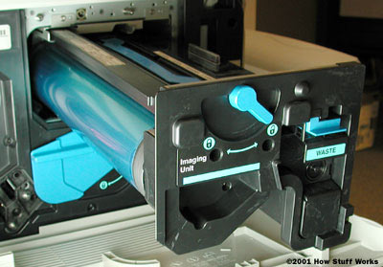
Laser Printer basics
The laser "writes" on a photoconductive revolving drum.
.

Slide 48
Toner based printers …
Laser Printer basics: Drum..
With the powder pattern affixed, the drum rolls over a sheet of paper, which is moving along a belt below. Before the paper rolls under the drum, it is given a negative charge by the transfer corona wire (charged roller). This charge is stronger than the negative charge of the electrostatic image, so the paper can pull the toner powder away. Since it is moving at the same speed as the drum, the paper picks up the image pattern exactly. To keep the paper from clinging to the drum, it is discharged by the detac corona wire immediately after picking up the toner.

Slide 49
Toner based printers …
Laser Printer basics: Fuser
Finally, the printer passes the paper through the fuser, a pair of heated rollers. As the paper passes through these rollers, the loose toner powder melts, fusing with the fibers in the paper. The fuser rolls the paper to the output tray, and you have your finished page. The fuser also heats up the paper itself, of course, which is why pages are always hot when they come out of a laser printer or photocopier.

Slide 50
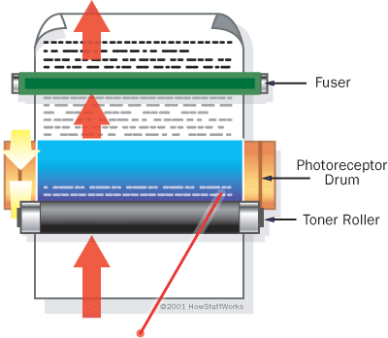
Laser Printer basics
The laser "writes" on a photoconductive revolving drum.
.

Slide 51
Toner based printers …
Laser Printer basics: Fuser…
So what keeps the paper from burning up? Mainly, speed -- the paper passes through the rollers so quickly that it doesn't get very hot.
After depositing toner on the paper, the drum surface passes the discharge lamp. This bright light exposes the entire photoreceptor surface, erasing the electrical image. The drum surface then passes the charge corona wire, which reapplies the positive charge.

Slide 52
Toner based printers …
Laser Printer Controller: The Conversation
Before a laser printer can do anything else, it needs to receive the page data and figure out how it's going to put everything on the paper. This is the job of the printer controller. The printer controller is the laser printer's main onboard computer. It talks to the host computer through a communications port, such as a parallel port or USB port. At the start of the printing job, the laser printer establishes with the host computer how they will exchange data. The controller may have to start and stop the host computer periodically to process the information it has received.

Slide 53
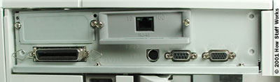
Laser Printer basics
A typical laser printer has a few different types of communications ports.

Slide 54
Toner based printers …
Laser Printer : Laser Assembly
Since it actually draws the page, the printer's laser system -- or laser scanning assembly -- must be incredibly precise. The traditional laser scanning assembly includes:
A laser
A movable mirror
A lens

Slide 55
Toner based printers …
Laser Printer : Laser Assembly …
The laser receives the page data -- the tiny dots that make up the text and images -- one horizontal line at a time. As the beam moves across the drum, the laser emits a pulse of light for every dot to be printed, and no pulse for every dot of empty space. The laser doesn't actually move the beam itself. It bounces the beam off a movable mirror instead. As the mirror moves, it shines the beam through a series of lenses. This system compensates for the image distortion caused by the varying distance between the mirror and points along the drum.

Slide 56
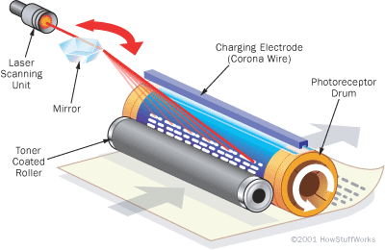
Laser Printer basics

Slide 57
Toner based printers …
Laser Printer : Writing the Page
The laser assembly moves in only one plane, horizontally. After each horizontal scan, the printer moves the photoreceptor drum up a notch so the laser assembly can draw the next line. A small print-engine computer synchronizes all of this perfectly, even at dizzying speeds. Some laser printers use a strip of light emitting diodes (LEDs) to write the page image, instead of a single laser. Each dot position has its own dedicated light, which means the printer has one set print resolution. These systems cost less to manufacture than true laser assemblies, but they produce inferior results.

Slide 58
Toner based printers …
Laser Printer : Toner Basics
One of the most distinctive things about a laser printer (or photocopier) is the toner. It's such a strange concept for the paper to grab the "ink" rather than the printer applying it. And it's even stranger that the "ink" isn't really ink at all. So what is toner? The short answer is: It's an electrically-charged powder with two main ingredients: pigment and plastic.

Slide 59
Toner based printers …
Laser Printer : Toner Basics…
The role of the pigment is fairly obvious -- it provides the coloring (black, in a monochrome printer) that fills in the text and images. This pigment is blended into plastic particles, so the toner will melt when it passes through the heat of the fuser. This quality gives toner a number of advantages over liquid ink. Chiefly, it firmly binds to the fibers in almost any type of paper, which means the text won't smudge or bleed easily.

Slide 60
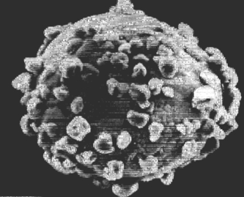
Laser Printer basics
A developer bead coated with small toner particles

Slide 61
Toner based printers …
Advantages of a Laser
The main advantages of laser printers are speed, precision and economy. A laser can move very quickly, so it can "write" with much greater speed than an ink jet. And because the laser beam has an unvarying diameter, it can draw more precisely, without spilling any excess ink.

Slide 62
Toner based printers …
Advantages of a Laser …
Laser printers tend to be more expensive than inkjet printers, but it doesn't cost as much to keep them running -- toner powder is cheap and lasts a long time, while you can use up expensive ink cartridges very quickly. This is why offices typically use a laser printer as their "work horse," their machine for printing long text documents. In most models, this mechanical efficiency is complemented by advanced processing efficiency.

Slide 63
Obsolete and special-purpose printing technologies
Dot Matrix Printer
A dot matrix printer or impact matrix printer refers to a type of computer printer with a print head that runs back and forth on the page and prints by impact, striking an ink-soaked cloth ribbon against the paper, much like a typewriter. Unlike a typewriter or daisy wheel printer, letters are drawn out of a dot matrix, and thus, varied fonts and arbitrary graphics can be produced. Because the printing involves mechanical pressure, these printers can create carbon copies and carbonless copies.

Slide 64
Obsolete and special-purpose printing technologies
Dot Matrix Printer…
Each dot is produced by a tiny metal rod, also called a "wire" or "pin", which is driven forward by the power of a tiny electromagnet or solenoid, either directly or through small levers (pawls). Facing the ribbon and the paper is a small guide plate (often made of an artificial jewel such as sapphire or ruby) pierced with holes to serve as guides for the pins. The moving portion of the printer is called the print head, and when running the printer as a generic text device generally prints one line of text at a time. Most dot matrix printers have a single vertical line of dot-making equipment on their print heads; others have a few interleaved rows in order to improve dot density

Slide 65

Obsolete and special-purpose printing technologies
Dot Matrix Printer

